Slide 1

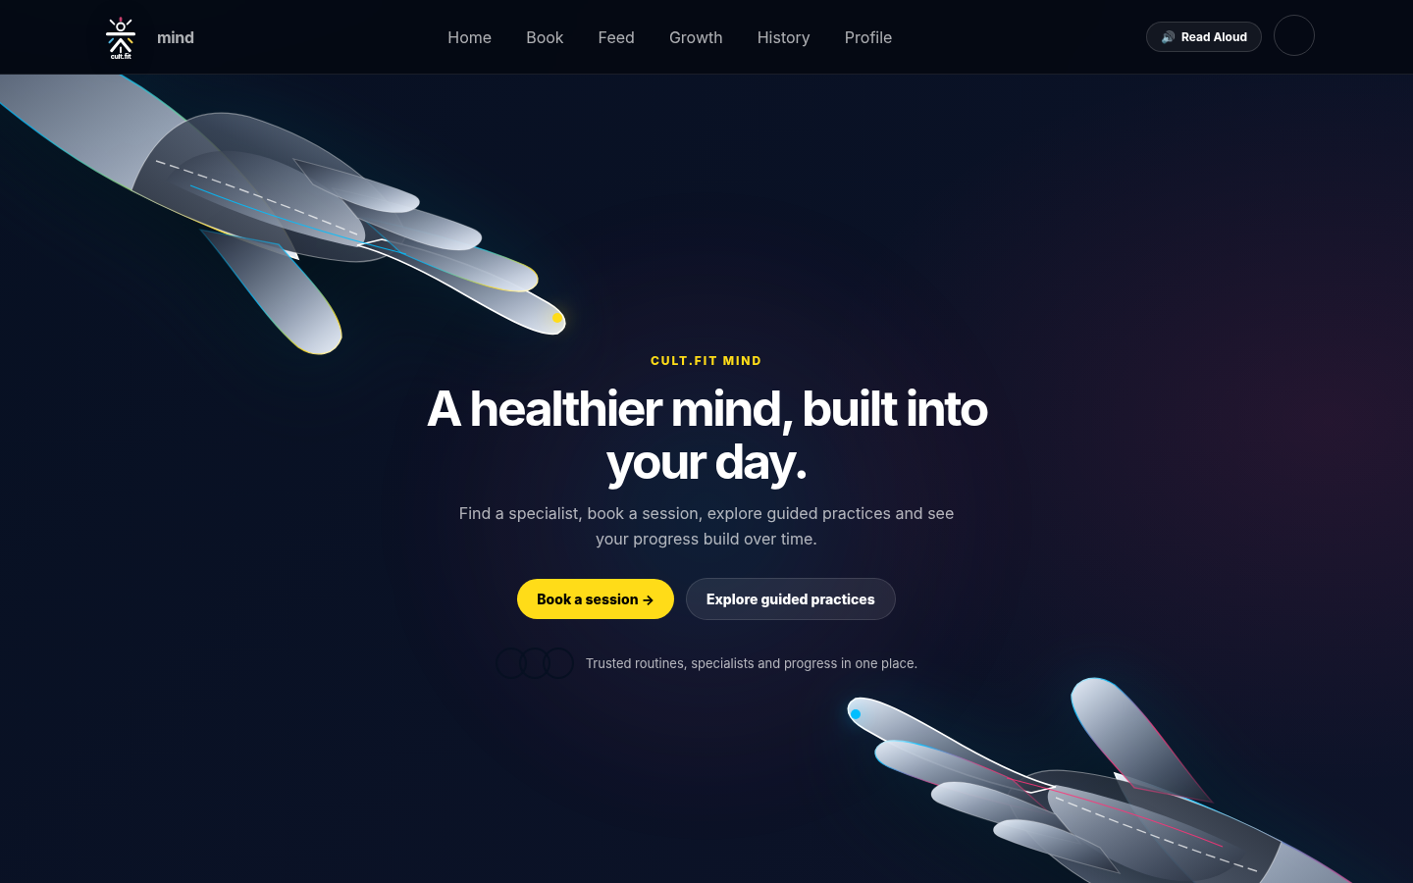
cult.fit × MIND
cultfit-mind / home
A healthier
mind, built into
your day.
A mental-wellness layer built into the cult.fit ecosystem — designed to feel familiar, useful, and human.
MENTAL FITNESS
PHYSICAL
HABITS
GROWTH
BODY → MIND → HABITS → GROWTH
01
Notes:
Open with the product, not the problem. One sentence: we extended the cult.fit self-improvement ecosystem from physical fitness into mental wellbeing.

Slide 2
02 / CONTEXT
The world is getting better at asking for help.
Approaching therapists and actually doing something about your mental health became mainstream. Mental wellbeing is becoming easier to talk about. The self-help and support space is expanding — but the ecosystem is still fragmented.
“
We have more access, information, self-help resources and professional support than previous generations.
PHYSICAL FITNESS
01
classes • training • progress
02
SELF-HELP
meditation • reflection • habits
SO WHY SHOULD CULT.FIT LIMIT ITSELF TO JUST PHYSICAL FITNESS?
03
PRO SUPPORT
specialists • therapy • continuity
FRAGMENTED → CONNECTED
04
WELLNESS TRACKING
mood • sleep • activity
02
Notes:
Make the audience feel the gap: people can find fitness, self-help and professional support, but these experiences are disconnected.

Slide 3
03 / OPPORTUNITY
What if fitness wasn’t just physical?
cult.fit already has permission to talk to people about improvement. The opportunity is to extend that relationship from physical fitness → mental fitness.
TODAY
NEXT
TOGETHER
Workout
Mind
One ecosystem
physical progress
emotional wellbeing
continuous support
THERAPY ACCESS + WELLNESS TRACKING + GUIDED CONTENT
THE CORE MOVE
Physical → Mental → Continuous care
becomes part of the same ecosystem rather than a separate experience.
03
Notes:
The key opportunity is not adding a random mental-health tab. It is extending the same improvement relationship into a new state of wellbeing.

Slide 4
04 / BRAND EXTENSION
We didn’t build a new brand. We extended one.
New experience, familiar ecosystem. The design keeps recognizable cult.fit cues while changing the emotional state of the interface.
LOGO
COLOUR
SAME PHILOSOPHY
retain recognition
energetic accents
HELP
ACCESS
BOOKING
TRACKING
familiar interaction
physical → mental
GROW
TRACK
The interface changes.
The ideology doesn’t.
04
Notes:
Explain brand fidelity: recognizable logo, colors, booking and tracking patterns remain. What changes is the emotional temperature.

Slide 5
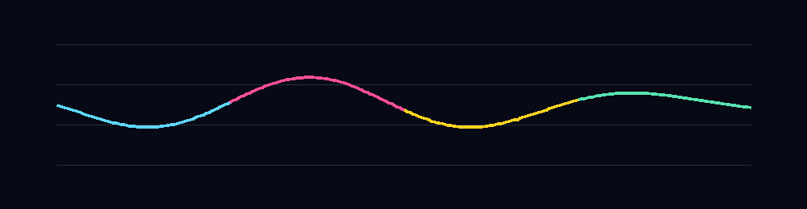
05 / DESIGN CHALLENGE
Same philosophy. Different state of mind.
Physical fitness can be energetic and performance-oriented. Mental wellbeing sometimes needs space, control, clarity and reduced stimulation.
ENERGY
CALM
PERFORMANCE
MENTAL WELLBEING
SHARED DNA
fast, stimulating, external goals
slower, spacious, reflective
simple, accessible, trackable
The UI keeps the brand’s energy — but lowers the cognitive temperature.
visual rhythm • softer gradients • atmospheric backgrounds • controlled motion
05
Notes:
This is the central design tension: keep cult.fit recognizable without bringing a high-performance emotional state into a reflective mental-wellness moment.

Slide 6
06 / VISUAL PSYCHOLOGY
Before the interface speaks, colour already does.
We used high-contrast accents strategically: yellow for action, blue/cyan for information, pink for emotional emphasis — against a dark, low-noise base.
132
42,266
64
DESIGN IMPLICATION
peer-reviewed articles
participants
countries represented
ACTION
high visibility
INFO
cool / low-arousal association
FEELING
emphasis / affect
ONE PALETTE, MANY STATES
EVIDENCE ≠ “CALM SWITCH”
yellow → action • blue/cyan → information • pink → emotion
Colour–emotion links are systematic associations; context, hue, lightness and saturation still matter.
COLOUR CAN ALSO MODULATE MEASURABLE BRAIN ACTIVITY
EEG studies report distinguishable frequency-band changes under different colour stimuli; interpretation depends on the task and setup.
Source: Jonauskaite & Mohr, Psychonomic Bulletin & Review (2025). EEG evidence framed as experimental, not deterministic.
06
Notes:
Name-drop the 2025 systematic review. Then say the design claim carefully: colour affects perception and is associated with affective dimensions; it is not a deterministic neurochemical switch.

Slide 7
07 / COGNITIVE LOAD
One screen. One thought. One next step.
When the user may already be carrying more, the interface should ask less from them.
TOO MUCH, TOO SOON
FOCUSED FLOW
7 competing prompts
Have you explored
therapy before?
+ 3 choices + progress anxiety
goal
sleep
mood
YES
NO
SKIP
habit
therapy
journal
support
profile
results
answer → next question → saved progress
The interface asks less — because the user may already be carrying more.
Source: GOV.UK Design System — Question pages / Service Manual — form structure.
07
Notes:
This is where you make the UX philosophy concrete. One thing per screen reduces choice overload and keeps the next action obvious.

Slide 8
08 / PEOPLE
Designed for the person behind the screen.
Three broad user states guided the onboarding and personalization logic.
01
02
03
THE FIRST-TIMER
THE EXPERIENCED USER
THE CULT.FIT MEMBER
Therapy feels unfamiliar. Needs context, control and no pressure.
Already understands therapy. Needs continuity and personalization.
Comfortable with fitness. New to mental wellbeing.
“I don’t know where to start.”
“I want this to remember me.”
“I track my body. Can I track my mind?”
ONBOARDING ISN’T A QUIZ. IT’S A HANDSHAKE.
Ask only what helps the next step feel personal.
08
Notes:
Introduce the three states. The same feature should feel different depending on whether someone is completely new, experienced, or already a cult.fit member.

Slide 9
09 / EMOTIONAL SENSITIVITY
Not every thought needs a form.
The onboarding is deliberately optional: skip, change, or answer later. The product invites reflection instead of interrogating the user.
cultfit-mind / onboarding
OPTIONAL DISCLOSURE
01
No forced personal disclosure.
02
NEUTRAL LANGUAGE
No diagnostic-looking questionnaire.
03
FLEXIBLE PATH
Skip or change an answer.
04
PROGRESSIVE DETAIL
Ask only what the next step needs.
09
Notes:
Emphasize consent and control. The product invites reflection; it does not force disclosure.

Slide 10
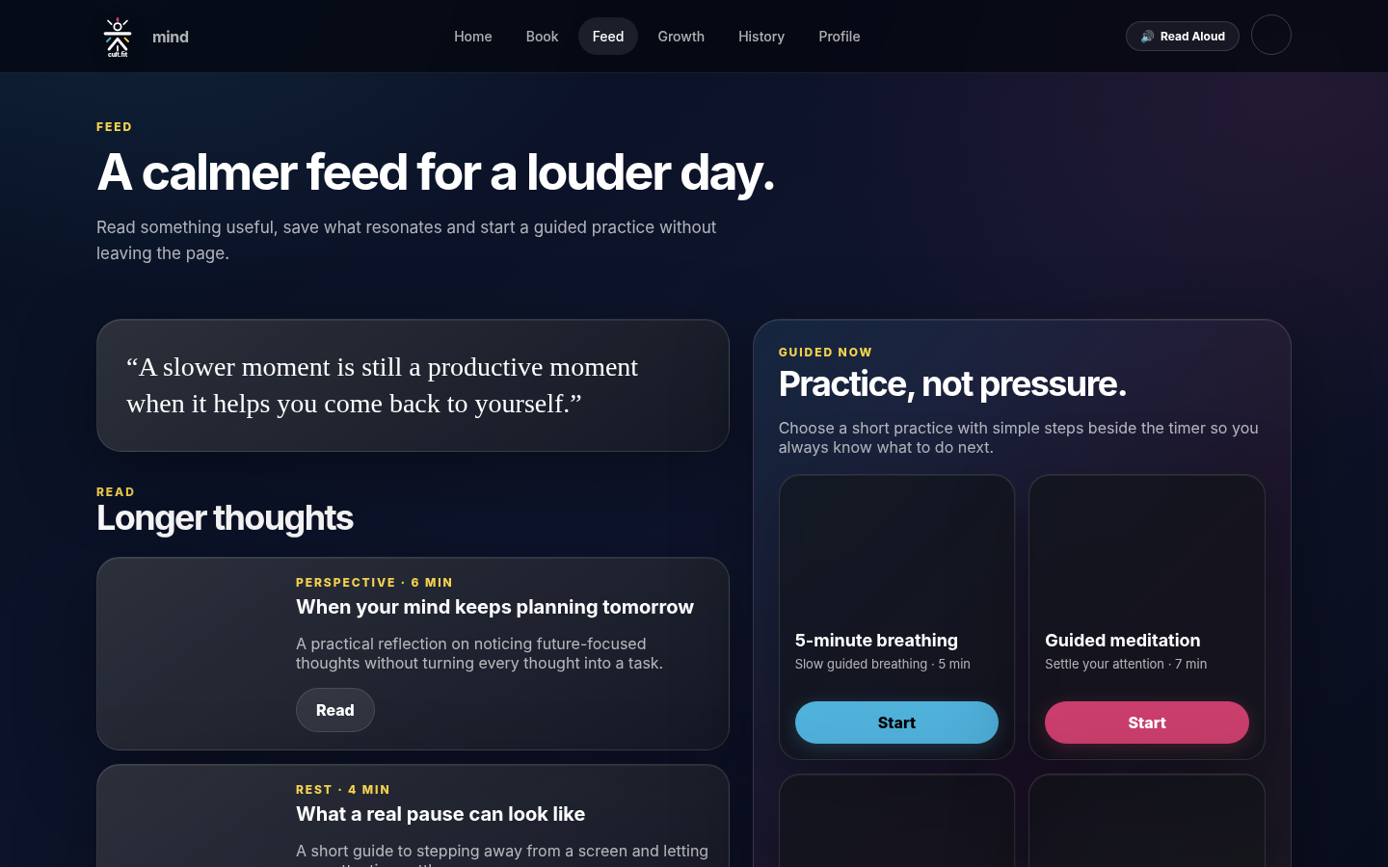
10 / FEED
A scroll that gives something back.
A feed can be familiar without reproducing the same pressures. Here, scrolling is used for reflection, short practices, reading, and grounded prompts.
cultfit-mind / feed
WHAT THE FEED OPTIMIZES FOR
REFLECTION
reflection > performance
LONGER THOUGHTS
read something useful
PRACTICE
try something small
GUIDED CONTENT
learn without performing
NO PUBLIC SCORECARD
no pressure to perform
SCROLL → REFLECT → TRY → CONTINUE
10
Notes:
Avoid saying “Instagram is bad.” Say: we reused a familiar interaction pattern but changed what it rewards — reflection, practice and useful content rather than public performance.

Slide 11
11 / RESEARCH
The problem isn’t scrolling. It’s what the scroll asks you to compare.
Recent evidence links higher online social-comparison tendencies with body-image concerns, eating-disorder symptoms and lower positive body image. So, we asked a different UX question: what should the feed reward?
2025 SYSTEMATIC REVIEW + META-ANALYSIS
WE FLIPPED THE INCENTIVE
83 studies · 55,440 participants
COMPARE
→
REFLECT
Body-image concerns
+0.454
PERFORM
→
PRACTICE
Eating-disorder symptoms
+0.360
OPTIMIZE
→
RECOVER
Positive body image
-0.242
LOOK PERFECT
→
FEEL BETTER
weighted average correlation (r)
Source: Bonfanti et al., Body Image 52 (2025), DOI 10.1016/j.bodyim.2024.101841. Correlations are associations, not causal effects.
11
Notes:
This is your strongest research graph. Point to the actual r values, then immediately say these are associations, not causal proof.

Slide 12
12 / ACCESSIBILITY
Accessibility isn’t a feature. It’s a default.
The same calm interface should remain usable when vision, motion tolerance, focus, or reading mode changes.
people with near or distance vision impairment globally
WCAG 2.2 AA minimum contrast for normal text
text resize target without losing content or function
2.2B
4.5:1
200%
01
READ ALOUD
02
FOCUS VISIBLE
SpeechSynthesisUtterance + visible control
keyboard users see where they are
03
REDUCED MOTION
04
RESPONSIVE
honour prefers-reduced-motion
content reflows instead of trapping
WHO: at least 2.2 billion people globally have near or distance vision impairment.
W3C WCAG 2.2 • WHO (2026)
12
Notes:
Accessibility is part of the product promise. Name-drop WHO and WCAG. The strongest point is that these ideas are implemented, not theoretical.

Slide 13
13 / MOTION
Motion is a system, not confetti.
Animation should guide attention, not demand it. We use soft transitions, restrained ambient movement, and a reduced-motion path for users who prefer less motion.
VISUAL RHYTHM
SOFT
PREDICTABLE
OPTIONAL
slow drift, not sudden jumps
same interaction → same response
reduced motion when preferred
prefers-reduced-motion: reduce
→ reduce non-essential transitions + animation
W3C 2.3.3
MDN
Sources: W3C WCAG 2.2 / SC 2.3.3; W3C Technique C39; MDN prefers-reduced-motion; site implementation.
13
Notes:
This is the answer to “why so much motion?”: motion is used as hierarchy, not decoration. Then prove there is a reduced-motion route.

Slide 14
14 / SUPPORT
Some moments can’t wait for a booking.
A therapist appointment may take time. The product can still provide useful, immediate pathways — while keeping professional support visible when it is needed.
01
02
03
04
SELF-GUIDED
EDUCATION
TRACK
PRO SUPPORT
breathing • grounding • meditation
read • understand • reflect
mood • habits • patterns
specialists • continuity • booking
Not every problem needs an appointment. Not every problem can wait for one either.
continuous support > single touchpoint
14
Notes:
This is the emotional/ethical slide. The product should offer useful self-guided steps without pretending every situation is solved by a booking.

Slide 15
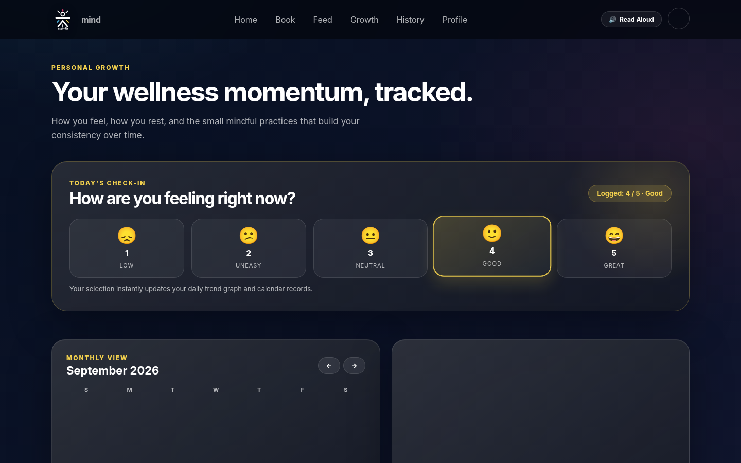
15 / GROWTH
We designed for patterns, not just moments.
Mood alone is not the point. The value is seeing how mood sits alongside sleep, activity, meditation, habits, journaling and therapy over time.
cultfit-mind / growth
7-DAY MOOD TREND
SLEEP
correlate rest with mood
JOURNAL
add context to a feeling
ACTIVITY
notice movement patterns
THERAPY
remember continuity
M
T
W
T
F
S
S
PATTERN > SNAPSHOT
15
Notes:
This is the product USP: tracking becomes useful when variables can be viewed together over time. Make clear the visual is conceptual, not a clinical metric.

Slide 16
16 / IMPLEMENTATION
The accessibility ideas actually exist in the code.
The design rationale is visible in the implementation: focus states, read-aloud, motion preferences, and responsive behaviour.
Focus-visible
:focus-visible { outline:none; box-shadow: … }
Keyboard clarity
Read Aloud
new SpeechSynthesisUtterance(textToRead)
Text → audio
Reduced Motion
@media (prefers-reduced-motion: reduce)
User-controlled motion
Sticky navigation
position: sticky; top: 0
Orientation / wayfinding
TECHNICAL DESIGN PRINCIPLE
Build the “kind” path into the default path: don’t bolt accessibility on at the end.
Source: submitted website source code; W3C / MDN accessibility guidance.
16
Notes:
This slide is the proof that accessibility was implemented, not just stated.

Slide 17
17 / DESIGN SYSTEM
Everything has a job.
A small front-end system keeps the site coherent: one visual language, repeated components, and motion that behaves consistently.
PALETTE
TYPE
MOTION
A healthier mind
Soft • predictable • optional
ACTION
INFO
EMOTION
POSITIVE
clear hierarchy / compact metadata / calm body copy
ambient drift / clear response / reduced-motion path
COMPONENTS
BUTTON
GLASS CARD
STATUS CHIP
PROGRESS
NAV
READ ALOUD
A component system makes every page feel like the same product: even when the user moves from feed → booking → growth → history.
cult.fit mind • product design pitch
17
Notes:
Use this to show front-end maturity. Every page uses the same components, hierarchy and motion rules.

Slide 18
18 / PRODUCT ARCHITECTURE
From check-in to change.
The entire experience can be understood as one loop: Check In → Explore → Get Support → Track → Reflect → Grow.
REFLECT
GROW
ONE ACTION AT A TIME
Each interaction is small.
The loop is what makes it meaningful.
THE PRODUCT IS THE LOOP
not just the booking page. not just the mood check.
CHECK IN
CONTINUITY > COMPLEXITY
TRACK
Each step creates context for the next one.
SUPPORT
EXPLORE
18
Notes:
This is the clean product-architecture story. Zoom out: the website is a loop, not a pile of screens.

Slide 19
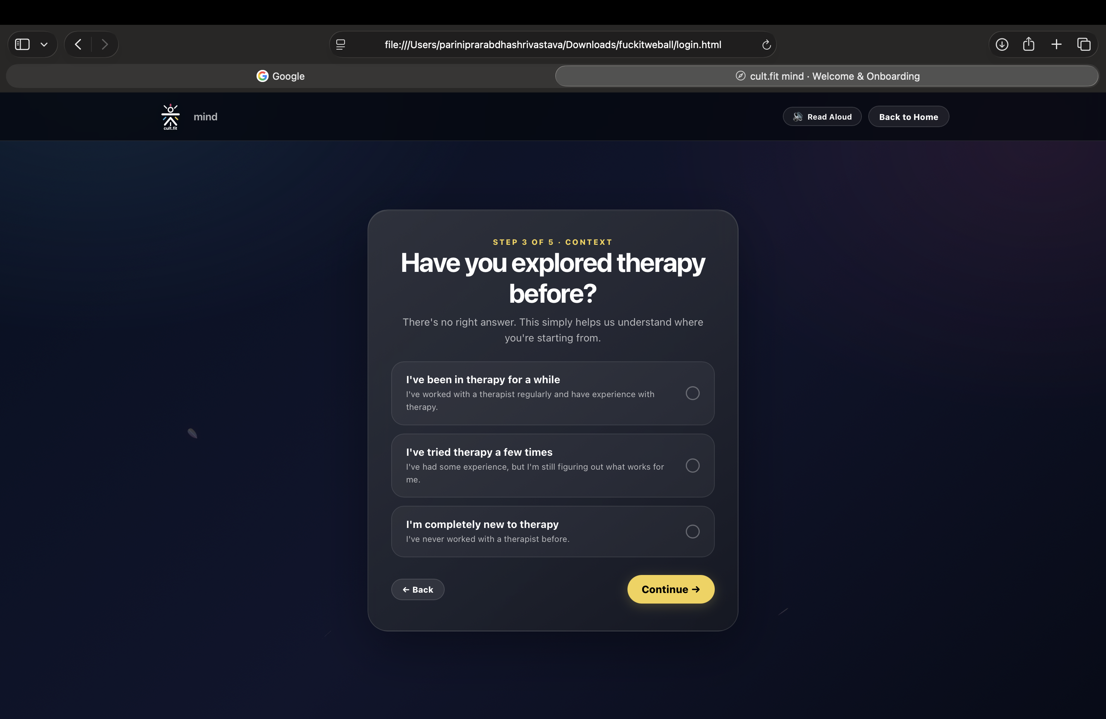
19 / PROOF
Let’s stop talking.
Experience it.
cultfit-mind / live
No screenshots. Show the interaction. Explain the reasoning while navigating.
HOME
ONBOARD
FEED
BOOK
GROWTH
1
2
3
4
5
Demo script
show the interaction → explain the reasoning → let the product prove the claim
19
Notes:
This should be the biggest proof section. Stop advancing slides here. Open the website and navigate the exact route shown.

Slide 20
20 / DIFFERENTIATION
A mental-health experience that still feels like cult.fit.
Our differentiation is not “we have therapists.” It is bringing mental wellbeing into an ecosystem users already understand: and extending familiar tracking and support behaviours into a more human context.
cultfit-mind / feed
01
FAMILIAR ECOSYSTEM
same brand language, different emotional state
02
HUMAN SUPPORT
specialists + continuity + immediate self-guided help
03
PATTERN TRACKING
mood alongside sleep, activity, habits and reflection
04
ACCESSIBILITY BY DEFAULT
read aloud + focus states + reduced motion + clear steps
THE DIFFERENCE IS THE CONNECTION
20
Notes:
This is the synthesis slide. The product is not differentiated by having therapists; the differentiation is the connected ecosystem and the way the interaction model translates across needs.

Slide 21
CLOSING
BODY. MIND.
HABITS. GROWTH.
cultfit-mind / home
cult.fit started with physical fitness. This proposal extends the ecosystem into mental wellbeing — without abandoning the identity people already recognize.
MIND × MOTION
A healthier digital experience for the whole person.
21
Notes:
Close on the four-part ecosystem: Body. Mind. Habits. Growth. Then pause.

